Slide 1


Processing & Core (Part 3)
April 2021
Not for distribution

Slide 2
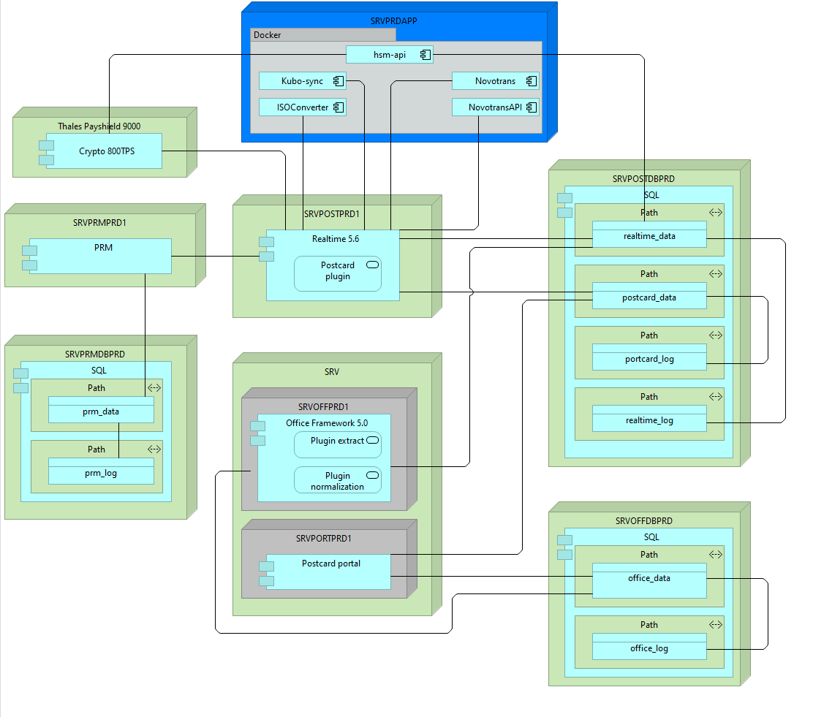
Integration Layer

Slide 3
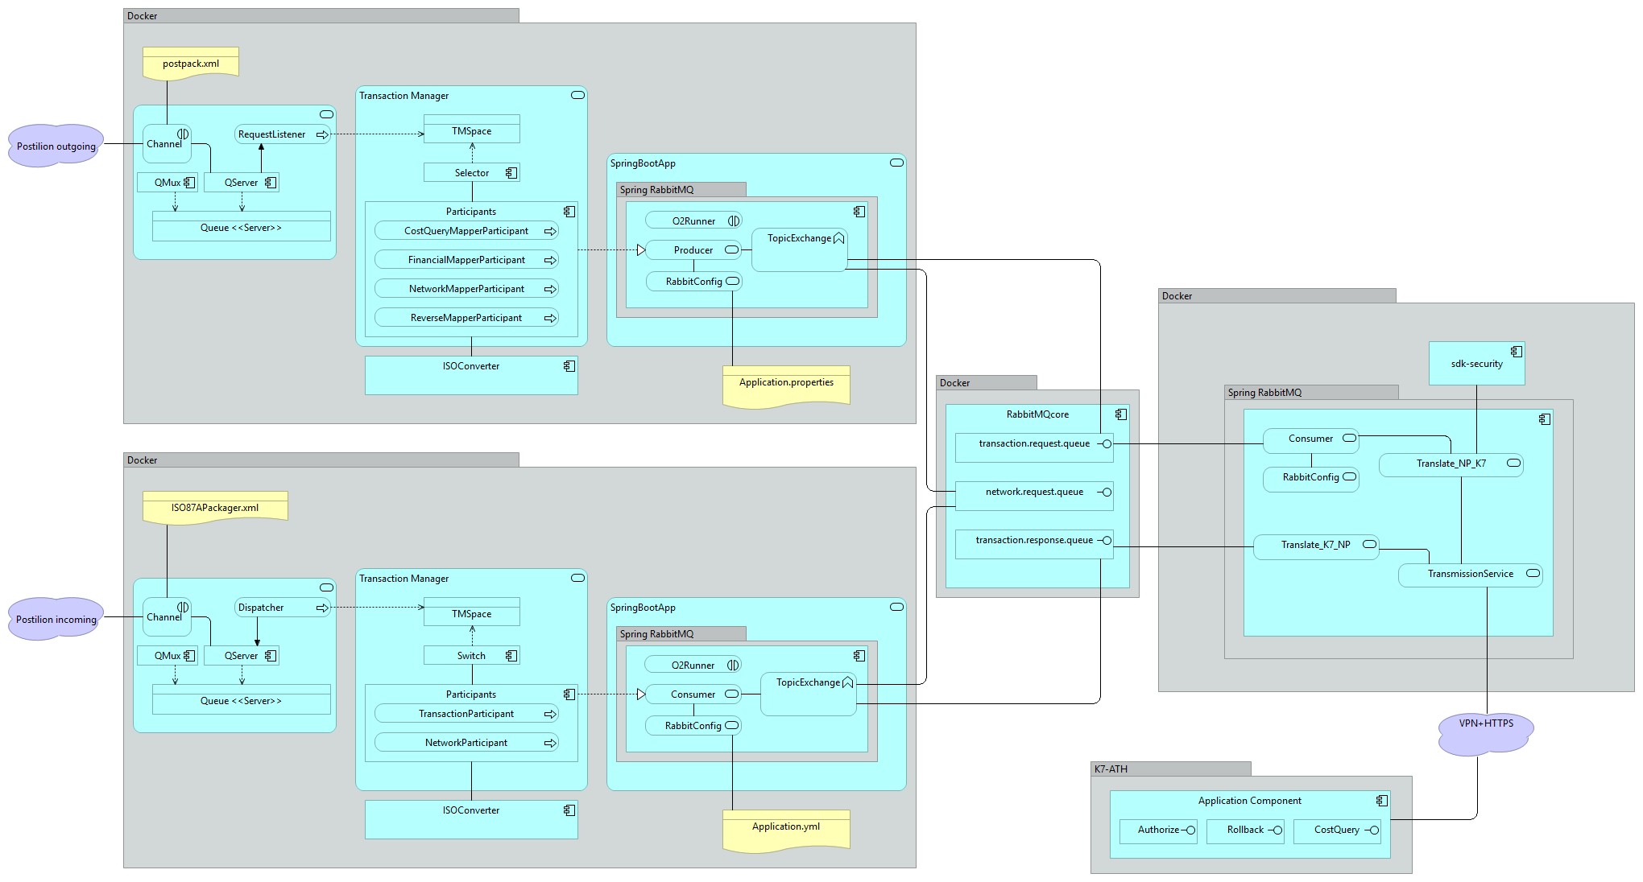
ISOConverter
SpringBoot
JPOS
Jackson
RabbitMQ

Slide 4
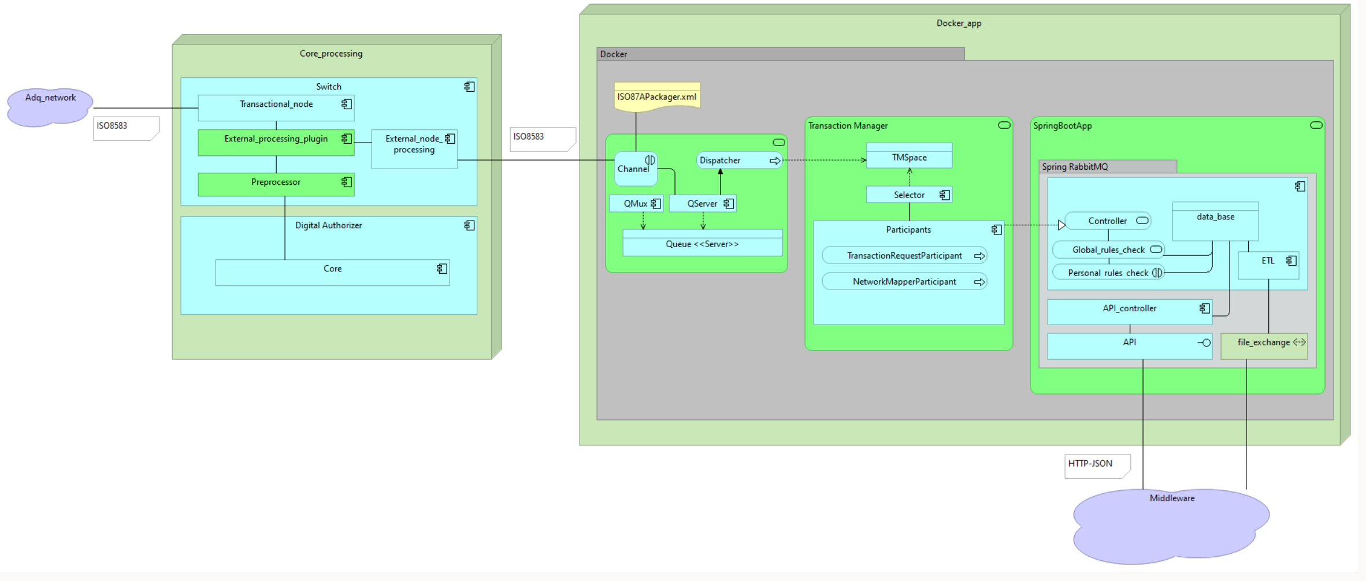
RVM

Slide 5

www.novopayment.com

